Slide 1
Marketing and Sales analytics
-by Parikshit Sohoni

Slide 2
What is Marketing Analytics
Marketing analytics is the study of data garnered through marketing campaigns in order to discern patterns between such things as how a campaign contributed to conversions, consumer behavior, regional preferences, creative preferences and much more
The goal of marketing analytics as a practice is to use these patterns and findings to optimize future campaigns based on what was successful.
This analysis allows marketers to achieve higher ROI on marketing investments by understanding what is successful in driving either conversions, brand awareness, or both.

Slide 3
Machine Learning for Marketing
Digital Marketing
Personalized ads
Automated email campaigns
Recommendation engine
Offline Marketing
RFM score for customer segmentation
Customer lifetime value prediction
Propensity models

Slide 4
Propensity Models
Propensity models give us the probability of a customer to buy in the next X months
Consider an ecommerce platform selling hand made jewelry
You have access to 2 years of their data, such as you know the following attributes of a customer
Age
Location
Education background
Products bough

Slide 5
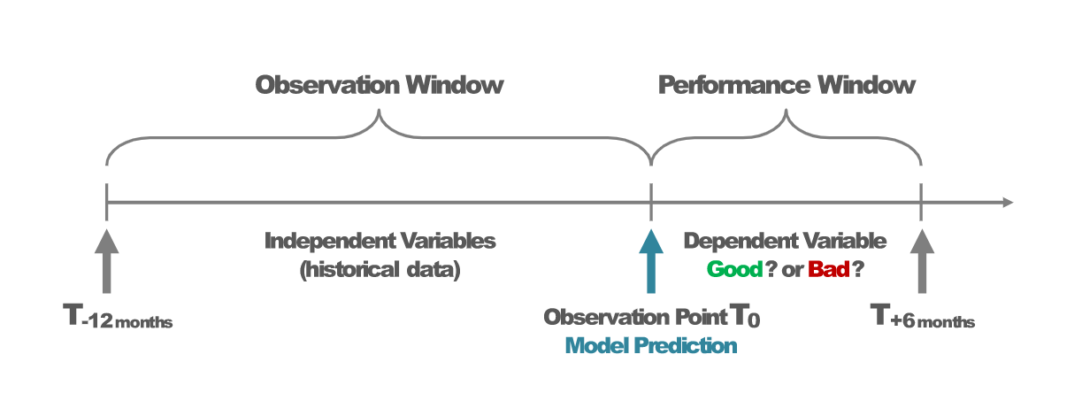
Data preparation
We need to split the data into two windows called as performance window and observation window

Slide 6
Data preparation
Performance window gives us the dependent variable
Observation window gives us the independent variables
The performance and observation windows can vary based on the application
It can be as short as one week and as long as a year

Slide 7
Modelling
Variable selection is done based on Information value and correlation
Selected variables are used for building a model
The model is built to classify a customer as “will buy again” or “will not buy again”
Each customer is assigned a probability to buy
This probability to buy is then divided into 10 bins

Slide 8
Propensity Model Output
Rank Group | # of customers | Custoemrs who bought again | Customers who didn’t buy again | % bought again
1 | 1000 | 402 | 598 | 40%
2 | 1000 | 370 | 630 | 37%
3 | 1000 | 320 | 680 | 32%
4 | 1000 | 290 | 710 | 29%
5 | 1000 | 180 | 820 | 18%
6 | 1000 | 165 | 835 | 17%
7 | 1000 | 125 | 875 | 13%
8 | 1000 | 80 | 920 | 8%
9 | 1000 | 60 | 940 | 6%
10 | 1000 | 16 | 984 | 2%

Slide 9
RFM and customer segmentation
Why do we need customer segmentation?
Segmentation using business logic:
Segmentation based on product
Segmentation based on High value customers
Segmentation based on location
Segmentation based on Churn
Segmentation using RFM

Slide 10
RFM
RFM stands for
R- Recency
F- Frequency
M- Monetary value
After generating an RFM score we can have categories like follows:
Low Value: Customers who are less active than others, not very frequent buyer/visitor and generates very low - zero - maybe negative revenue
Mid Value: In the middle of everything. Often using our platform (but not as much as our High Values), fairly frequent and generates moderate revenue.
High Value: The group we don’t want to lose. High Revenue, Frequency and low Inactivity.

Slide 11
RFM
As the methodology, we need to calculate Recency, Frequency and Monetary Value (we will call it Revenue from now on) and apply unsupervised machine learning to identify different groups (clusters) for each.

Slide 12
Data Exploration

Slide 13
RFM calculation

Slide 14
CUSTOMER LIFETIME VALUE

Slide 15
What is CLV
Customers are key assets to any business
Customer Loyalty can be determined by using the phases of a customer's relationship life cycle with the firm
Case Study of Netflix:
The market cap of Netflix is around $165 Billion dollars
Netflix is a company that has attributing a lot of their success to understanding customer relationships
Netflix’s biggest innovation was to change the business model and start a subscription service
A key factor of the subscription model, is that you need to understand customer relationships and keep the customers for a longer time

Slide 16
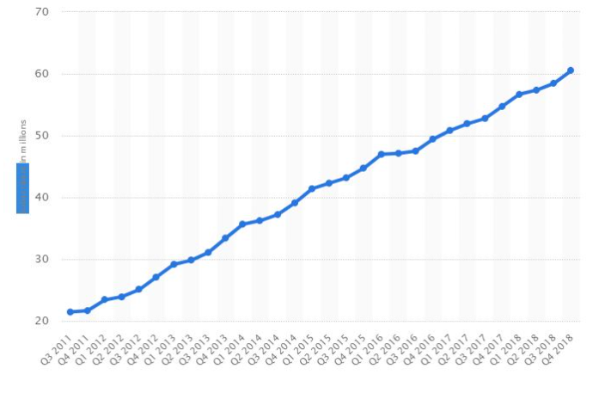
Customer Retention for Netflix

Slide 17
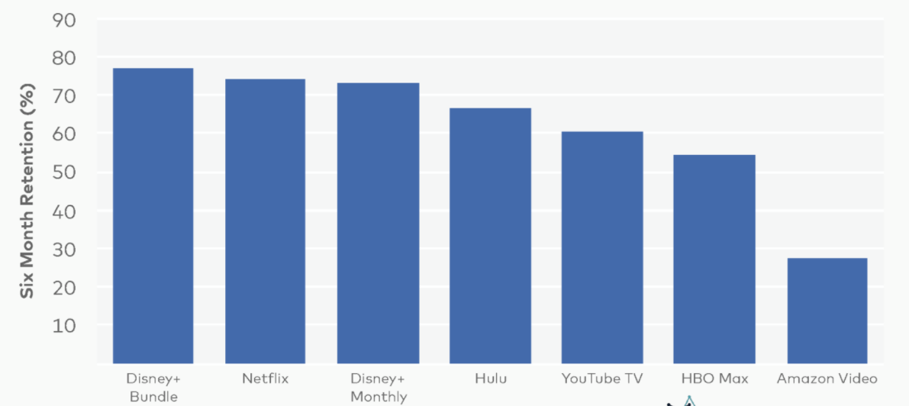

Slide 18
What did Netflix do right?
Even though the customer acquisition rate of Netflix has gone down, they have done a fabulous job in retaining customers.
The current retention rate of Netflix is around 70%
Netflix knows how much money to spend on each customer
This is because Netflix know what is the value of a customer

Slide 19
What is CLV ?
Customer Lifetime Value is the amount of value in dollars of a customer's relationship with the firm
It is both backward and forward looking
What is CLV used for?
It is used to determine:
How much to spend on acquiring a customer
How much to spend on retaining a customer

Slide 20
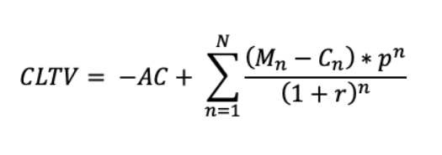
Formula for CLV
AC : Acquisition cost
Mn: Margin produced by the customer
n: Time period
Cn: Amount spent for marketing and servicing the
customer
p: Probability that the customer will not churn
N: Total number of years to calculate CLTV
r: Discount offered for each customer

Slide 21
Netflix Case study
Following metrics are overserved using historical data of Netflix
Expected Customer Lifetime in Months | 20M
Average Gross Margin per customer | $50
Average Marketing costs per customer | $0
Average net margin per customer | $1.5
Customer Lifetime Value | $1000

Slide 22
Basic CLV Model
Net Margin per Netflix Customer = M-R = $50
Retention rate = r = 80%
Number of customers who joined Netflix in June 2021 = 100
Month | Number of Customers | Total Net Profit | Total Net Profit | Present Value of
June 2021 | 100 | [M-R]*100 | 50*100 | 5000
July 2021 | r*100 = 80 | r*100*[M-R] | 80*50 | 4000
August 2021 | r*(r*100) = 80% of 80 | r²*100*[M-R]
September 2021 | r*(r*(r*100)= | r³*100*[M-R]

Slide 23
Basic CLV Model
$M | Contribution per period from active customer. Contribution = Sales Price= Variable Costs
$R | Retention Spending per period per active customer
r | Retention rate (fraction of current customers retained each period)
d | Discount rate per period
Final Formula | CLV = [$M-$R]x[(1+d)/(1+d-r)]

Slide 24
How to use the CLV model
The CLV model is looked in two components
Short Term Margin: Margin you get each period (one month for Netflix)
Long term Multiplier: Short term margin X Number of periods it recurs
CLV = [$M-$R]x[(1+d)/(1+d-r)]
[$M-$R] : Short term Margin
[(1+d)/(1+d-r)]: Long Term Multiplier
If Retention Increases:
Long Term Multiplier Goes Up
If a person is retained for longer, the retention rate goes up and so does the CLV

Slide 25
Problem statement
Netflix changes $19.95 per month.
Variable costs are $1.50 per month
Marketing Spending is $6 per month
Attrition rate is 1% per month
Monthly Discount rate is 1%
What is the CLV?
If Netflix decides to cut marketing Spending from $6 to $3, their attrition rate is expected to go up by 1%. Should they, do it?
$ M = 19.95-1.50 = $18.45
$R = 6/12 = $0.5
R = 0.995 = 1-0.05
d = 0.01
CLV = [$M-$R]x[(1+d)/(1+d-r)]
CLV = [18.45-0.5]x[(1+0.1)/1_0.01-0.995)]
CLV = [17.95]x[67.33]
CLV = $1209

Slide 26
Netflix changes $19.95 per month.
Variable costs are $1.50 per month
Marketing Spending is $3 per month
Attrition rate is 0.05% per month
Monthly Discount rate is 1%
$ M = 19.95-1.50 = $18.45
$R = 3/12 = $0.25
R = 0.99
d = 0.01
CLV = [$M-$R]x[(1+d)/(1+d-r)]
CLV = [18.45-0.25]x[(1+0.1)/1_0.01-0.99)]
CLV = [18.20]x[50.5]
CLV = $900

Slide 27
Learning from CLV
In old CLV the short-term margin was ~$17
After reducing the marketing spending, the short-term margin is $18.20
Long term multiplier has gone down from 67 months to 50 months
CLV reduced from $1209 to $919
It is not advisable to cut marketing spending to increase the CLV
Using the CLV formula, we can now see the effectiveness of marketing actions and also get and idea about how much to spend on retention

Slide 28
CLTV Model Building
Define an appropriate time frame for Customer Lifetime Value calculation
Identify the features we are going to use to predict future and create them
Calculate lifetime value (LTV) for training the machine learning model
Build and run the machine learning model
Check if the model is useful
To implement it correctly, we need to split our dataset. We will take 3 months of data, calculate RFM and use it for predicting next 6 months.

Slide 29
What is Random Forest
Random forest works on building multiple trees and then voting to see what is the majority output
For random forests to work, these multiple trees must be uncorrelated
To make sure that the trees are uncorrelated, following things are done
Random Forest Tree Building:
Bootstrapping/Bagging
The subset of data used for building a tree is randomly selected
Feature Randomness
The features which a tree can use is randomly selected

Slide 30
What is Gradient Boosting
Boosting is an ensemble technique where new models are added to correct the errors made by existing models
Boosting combines weak learners sequentially so that each new tree corrects the error of the previous one
Weak learners are usually decision trees with only one split called as decision stump
How well a decision tree does is calculated using a loss function

Slide 31
What is XGboost
XGBoost is an implementation of gradient boosted decision trees designed for speed and performance.
XGBoost stands for extreme Gradient Boosting.

